Slide 1
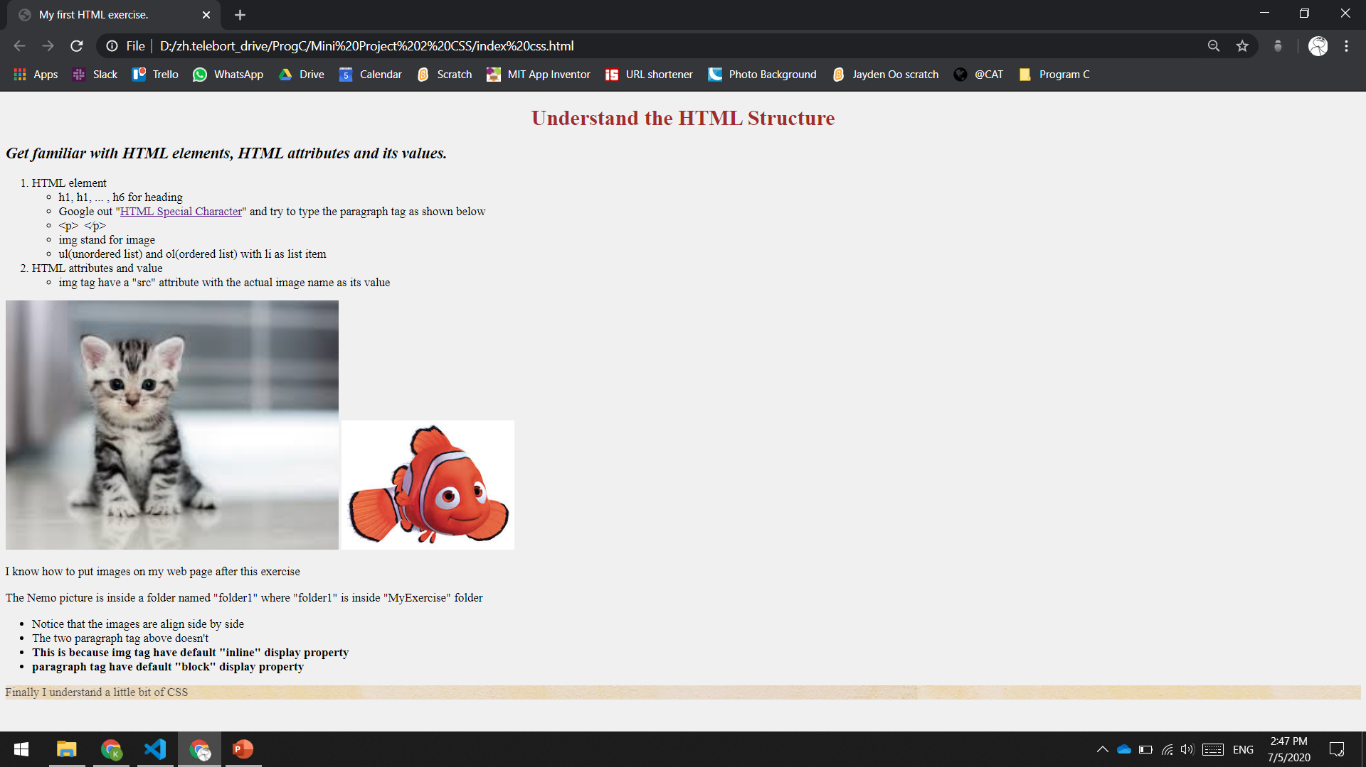
Use inline CSS, brown color, align to center
Use internal CSS, italic
image with width = 500px, targeted by “kitten-img” class
li and p having 18px font size
Body with background color #f0f0f0
p tag with background image and opacity 0.7
bold, targeted by “bold” class

